Slide 1
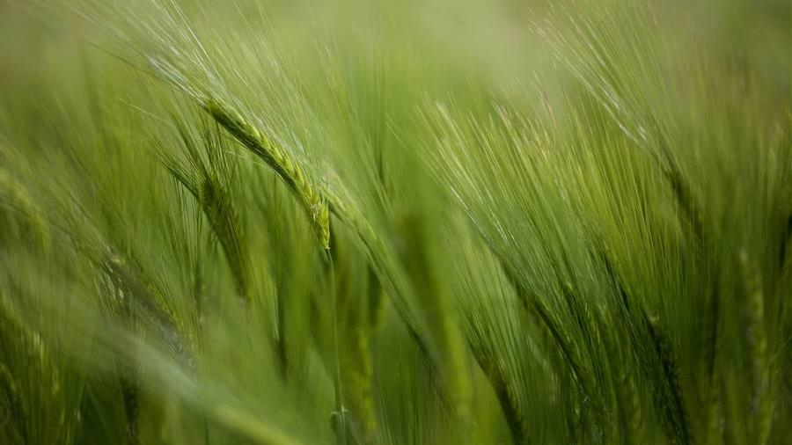
New South wales grazing study
Mel Beall
Nashville Software School - Data Analytics Cohort 9

Slide 2
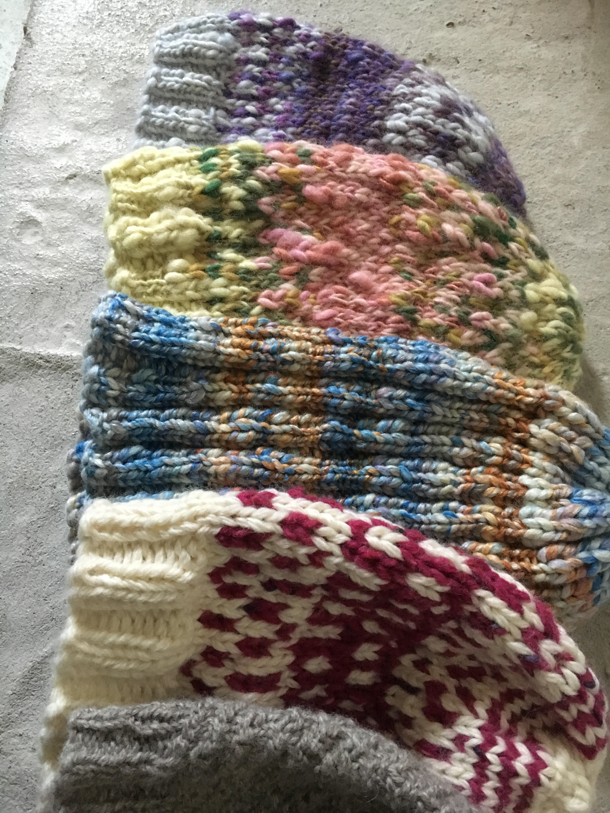
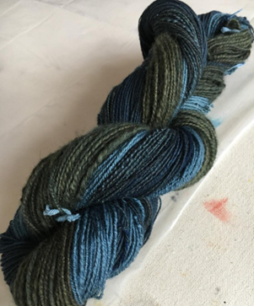
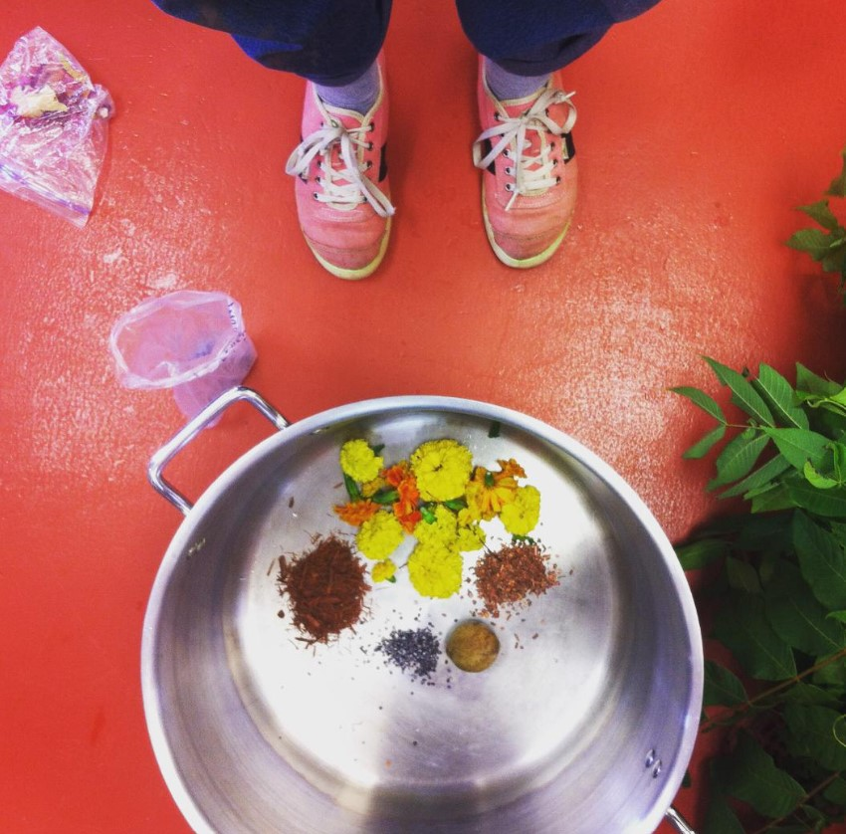
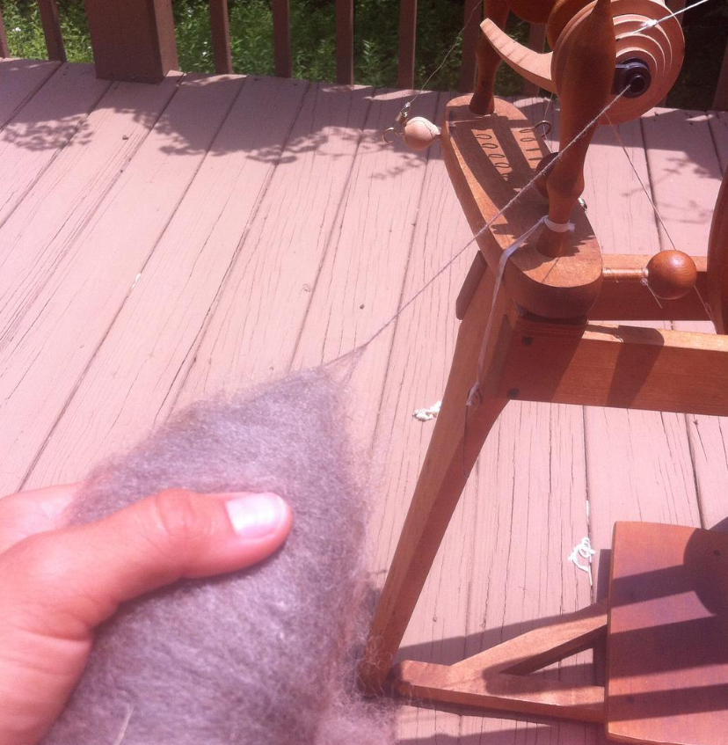


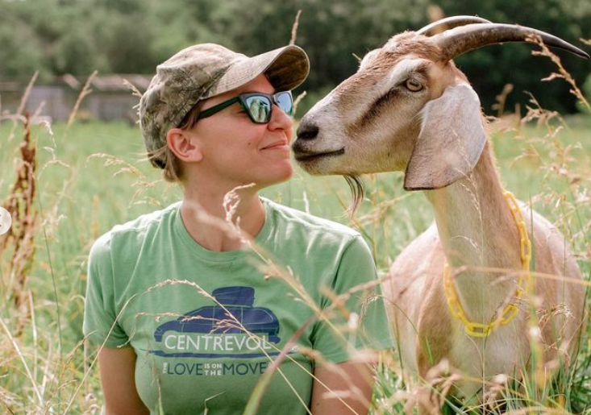
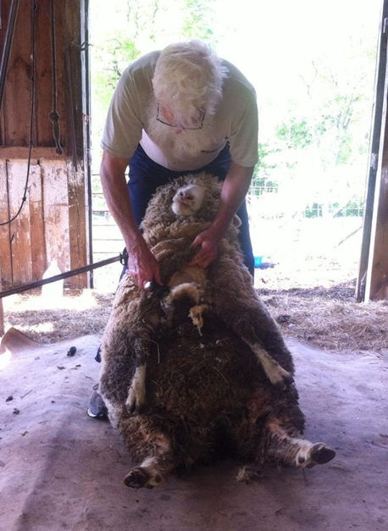
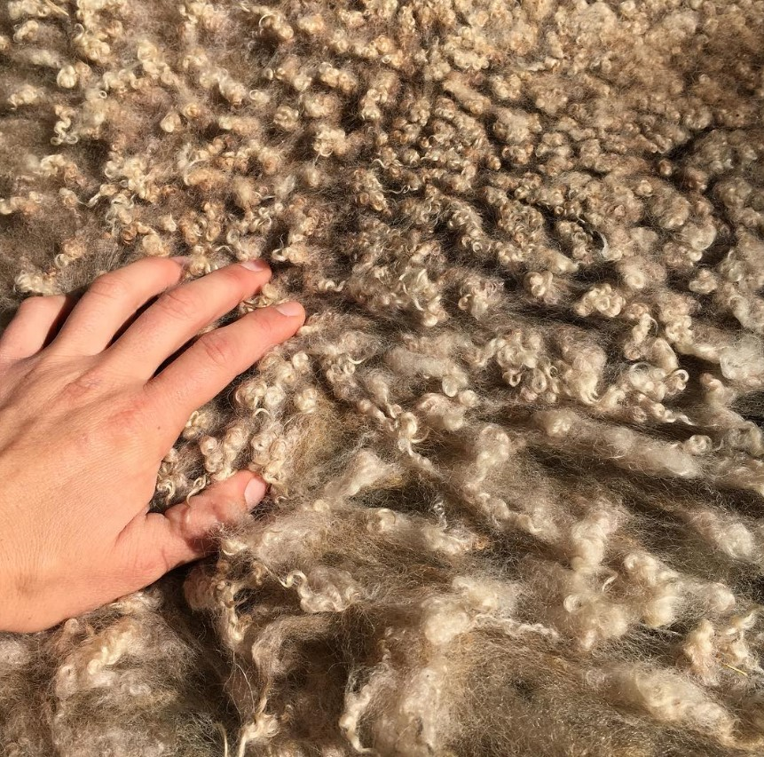
Motivation
Stress Relief
Yarn obsession
KNIT LIKE GRANDMA
HOW IT’S MADE
THE SOIL CYCLE
wool
RAW MATERIAL
grazing
ANIMAL HEALTH
SOIL IMPROVEMENT
CYCLE COMPLETION

Slide 3
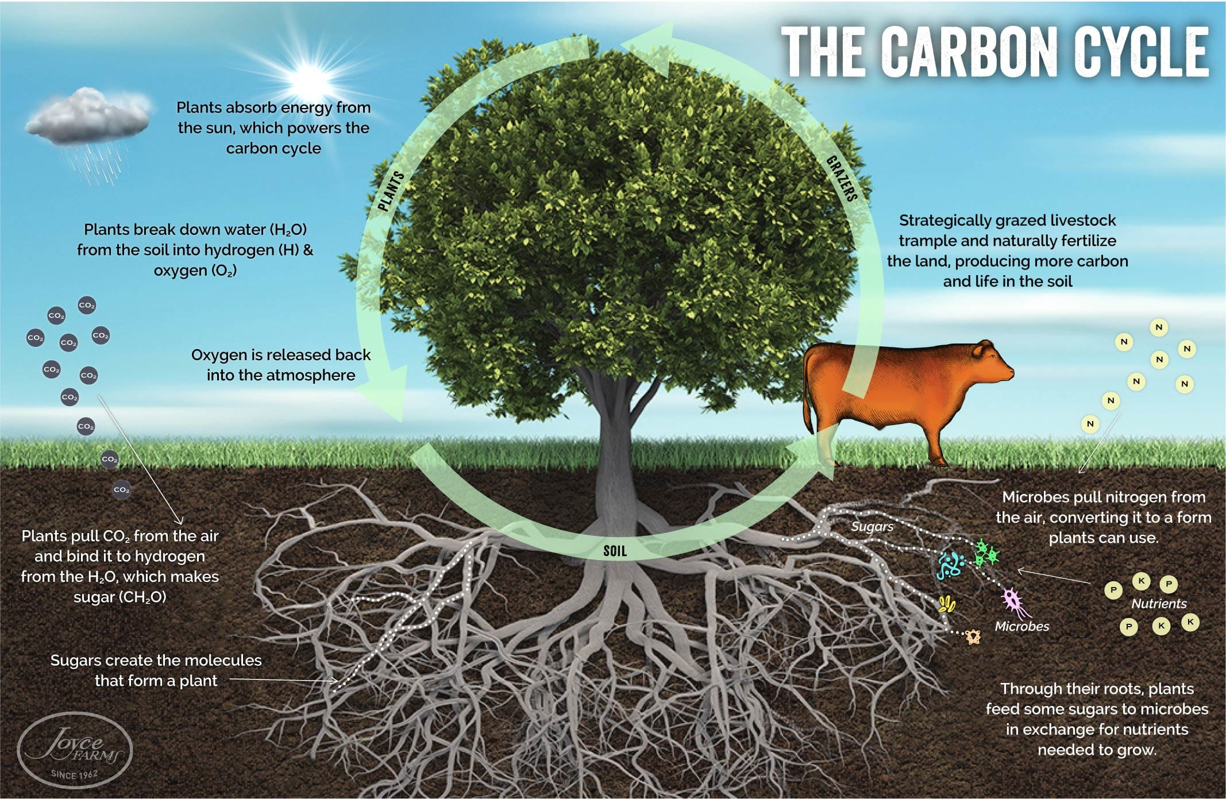
The carbon Cycle
“The final piece of the carbon cycle is grazing.
[…]
A ruminant is a solar-powered grass harvesting and processing miracle. Cattle that move across the land (using rotational grazing, eating no more than half the grass) leave partially digested biomass (i.e. manure and nitrogen-rich urine) spread evenly in their wake. What gets left behind is everything the grass needed to grow in the first place—a sort of customized fertilizer. Their trampling also provides an armor of plant life for the soil and feeds the soil microbes, producing new carbon and stimulating new soil life.”
Image courtesy of Dr. Allen Williams, Ph.D.
The Circle of Life: How the Carbon Cycle Powers our Ecosystem — Northeast Recycling Council (nerc.org)

Slide 4
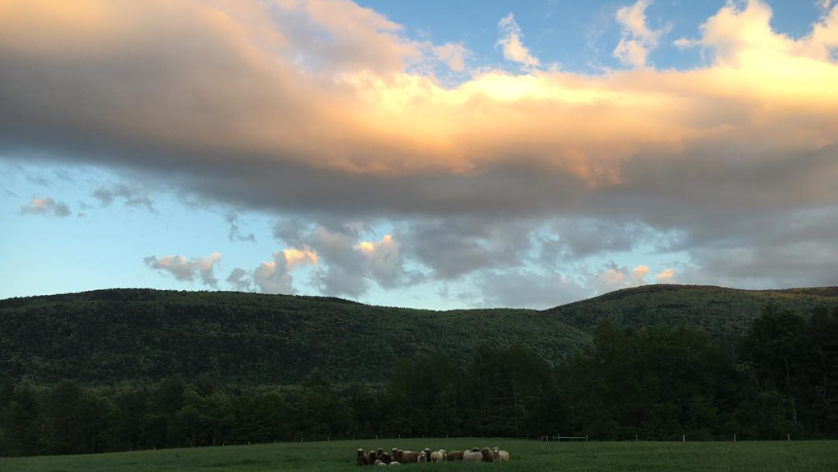

project overview
NEW SOUTH WALES GRAZING STUDY
FOUR DATASETS
THREE COMMUNITIES
54 SITES
THREE YEARS

Slide 5
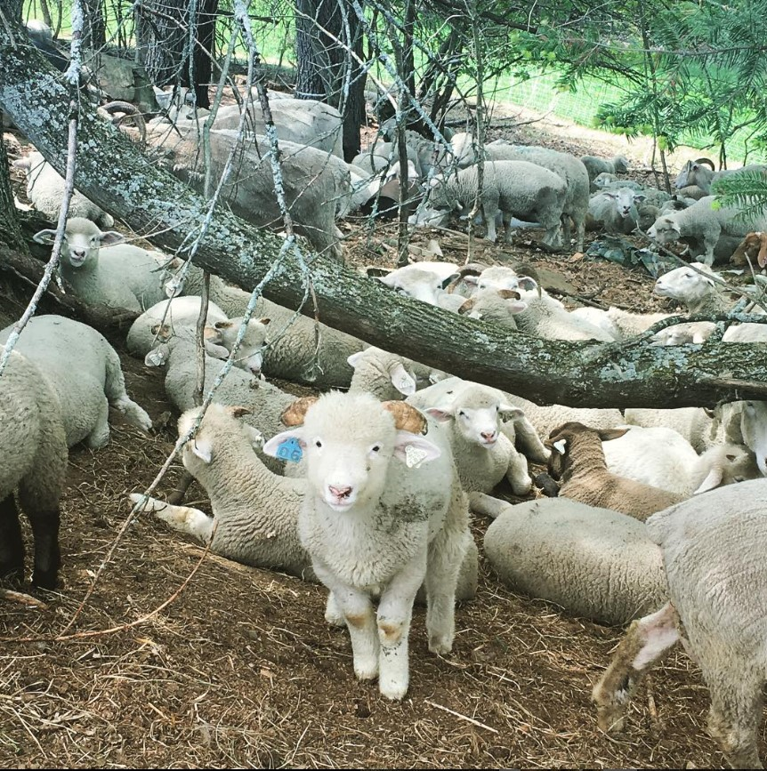
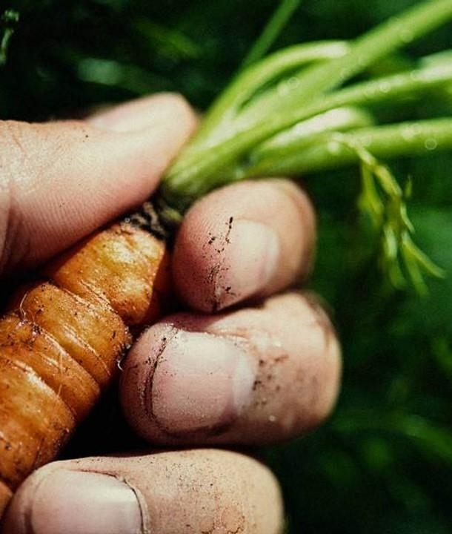
project overview
1​
What are the primary indicators of soil quality?
Chemical
Physical
2
What is growing?
Grasses/Shrubs
Invasives/Natives
3
Which animals have the largest impact?
Carbon deposits in dung
Soil disturbance

Slide 6
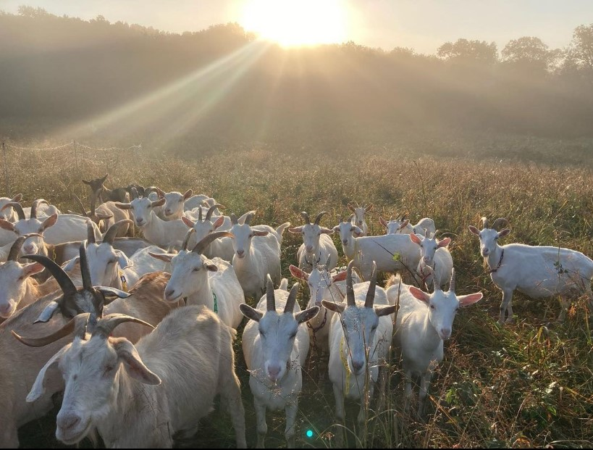
Interpretability of Scientific terminology
Project limitations

Slide 7
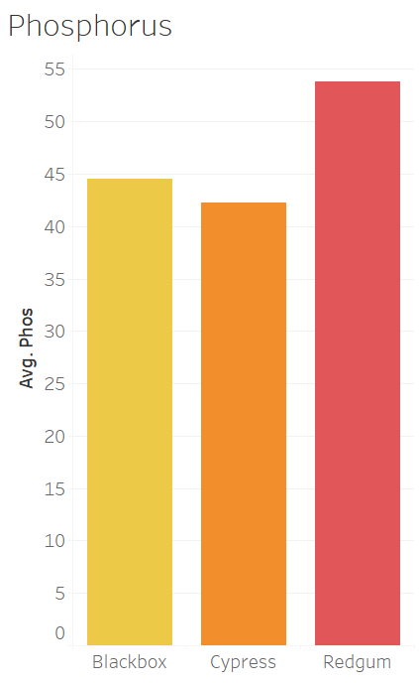
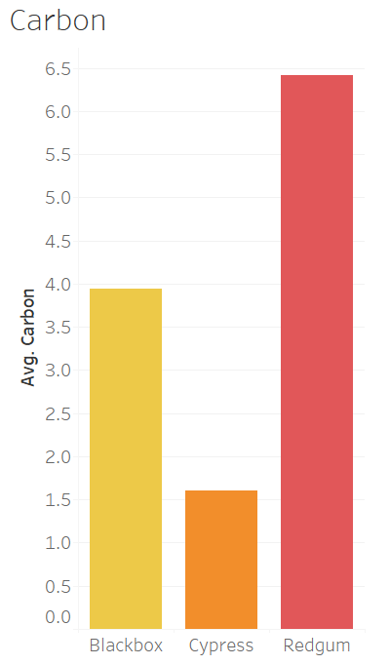
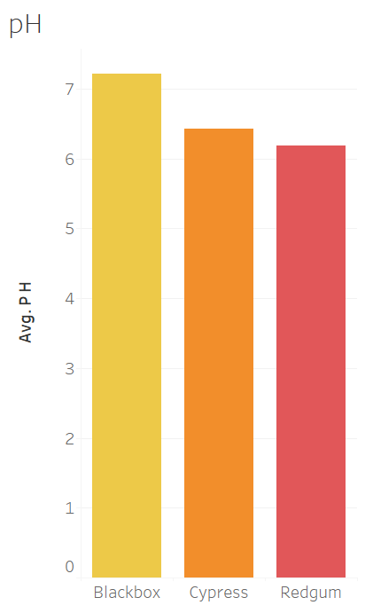
Soil health
IDEAL PHOSPHORUS
15–20 mg/kg for dryland pastures
25–30 mg/kg for irrigated and improved pastures
30–50 mg/kg for tree crops
50+ mg/kg for vegetables

Slide 8
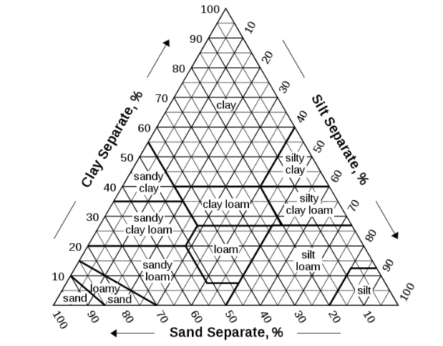
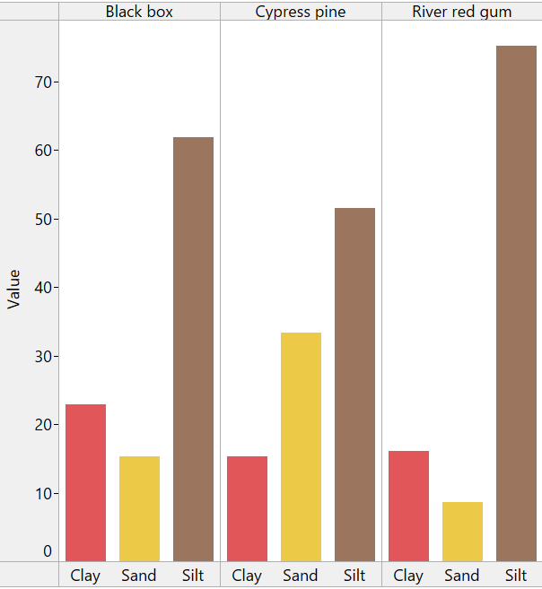
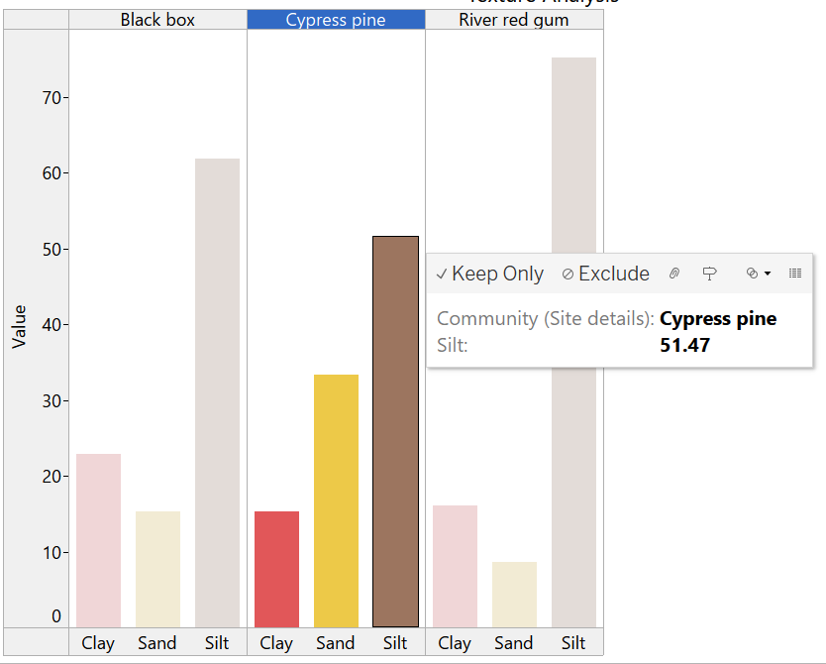
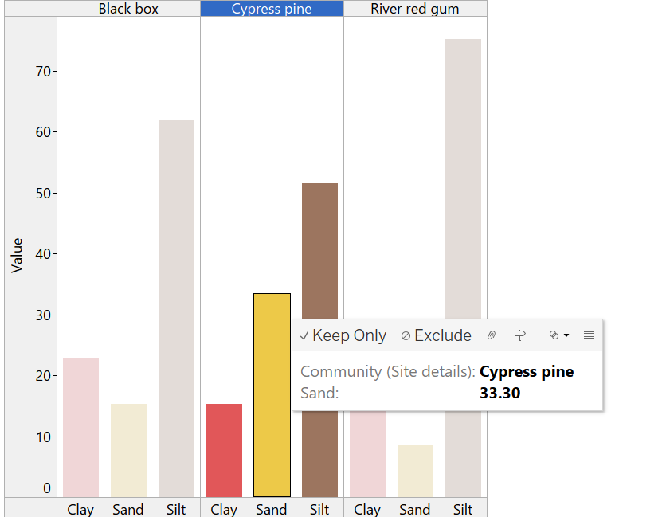
TEXTURE ANALYSIS
Image Courtesy of USDA Soil Survey Division Staff

Slide 9
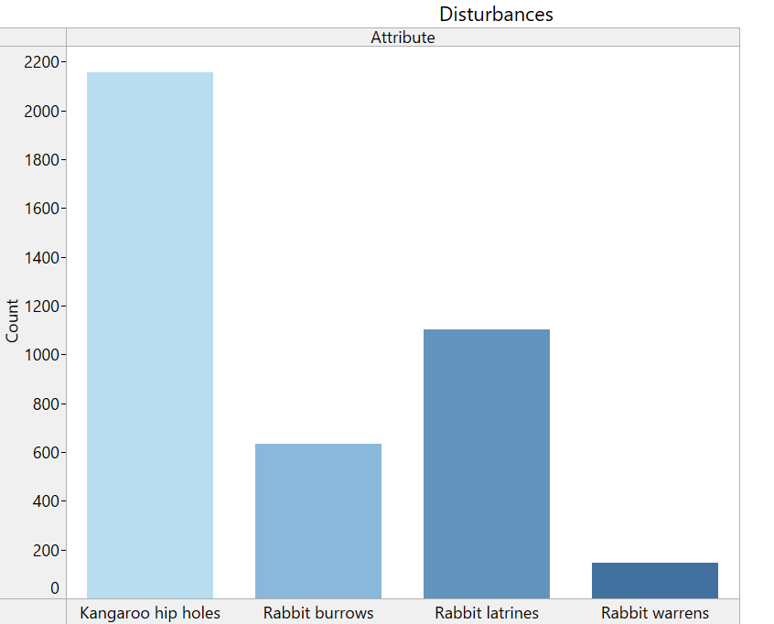
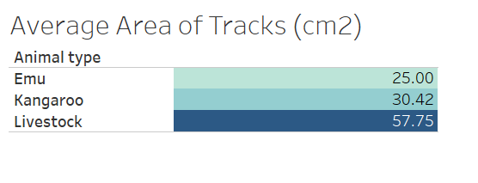
Animal impact

Slide 10
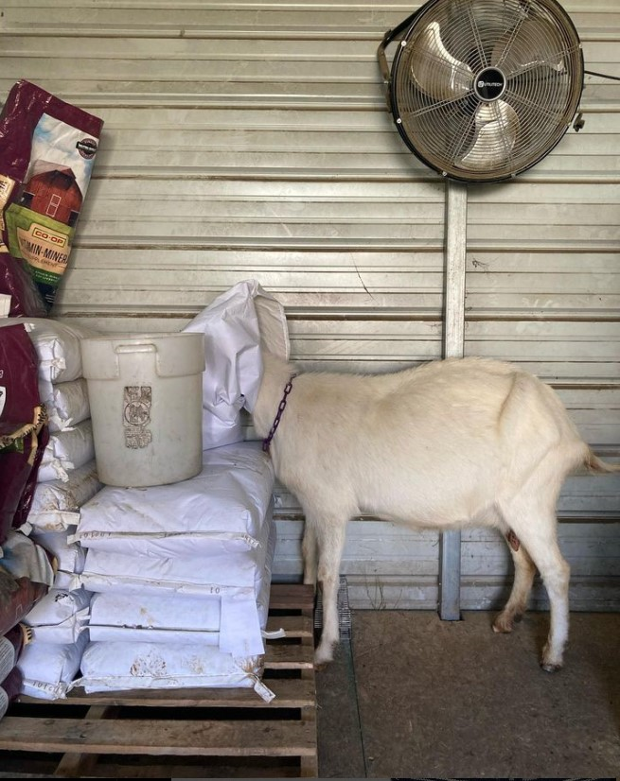
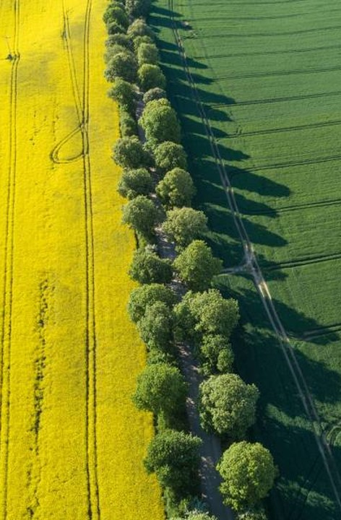
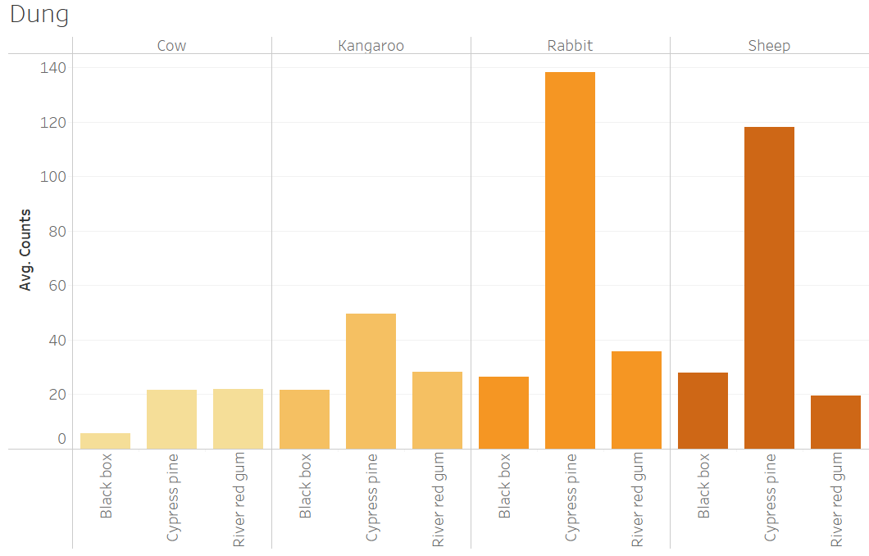
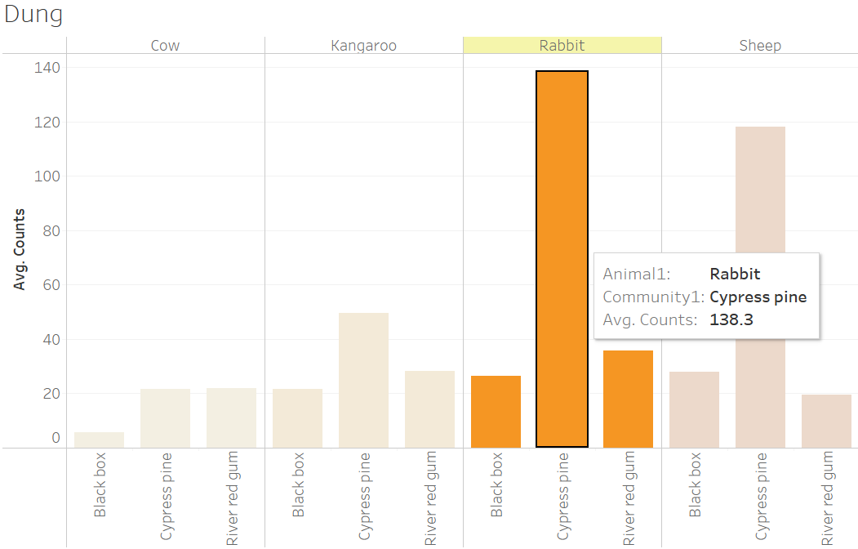
Grazing intensity
Large (5m x 5m)
Cattle
Sheep/goat
Kangaroo
Small (0.5m x 0.5m)
Kangaroo
Rabbit
Sheep/goat

Slide 11
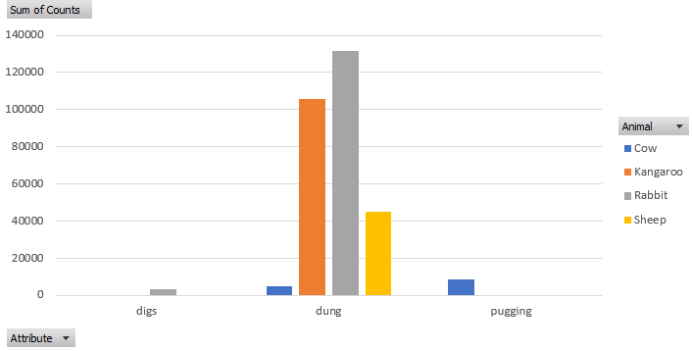
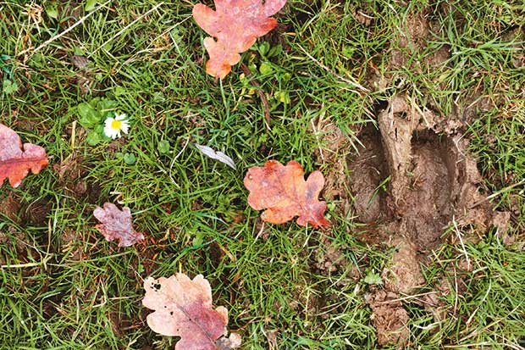
PUGGING
Compaction of soil due to herd ambulation
Impacts moisture content, infiltration, and aeration

Slide 12
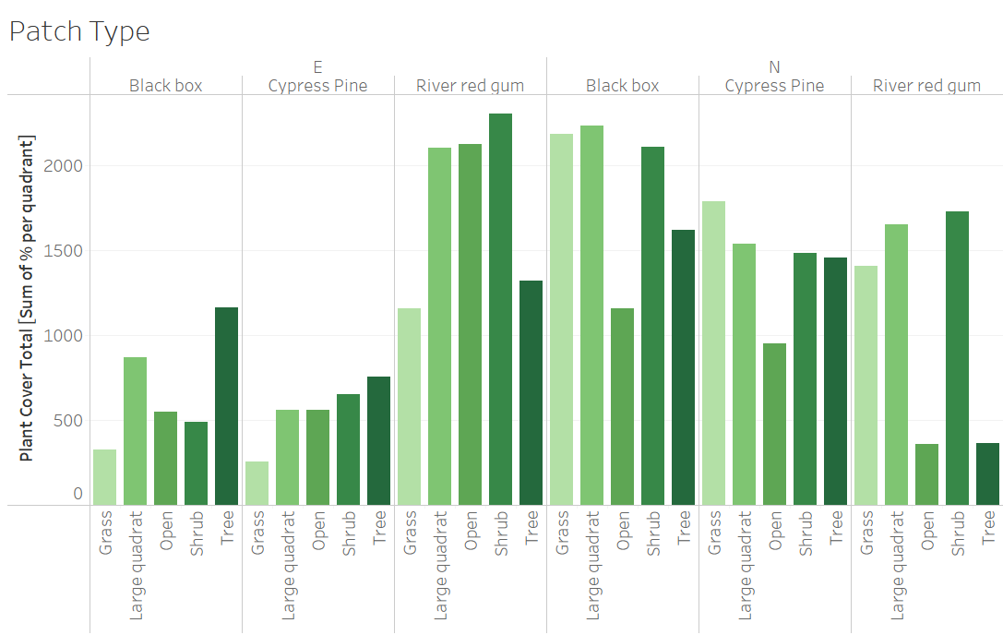
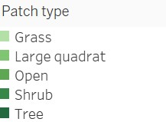
Cover story

Slide 13
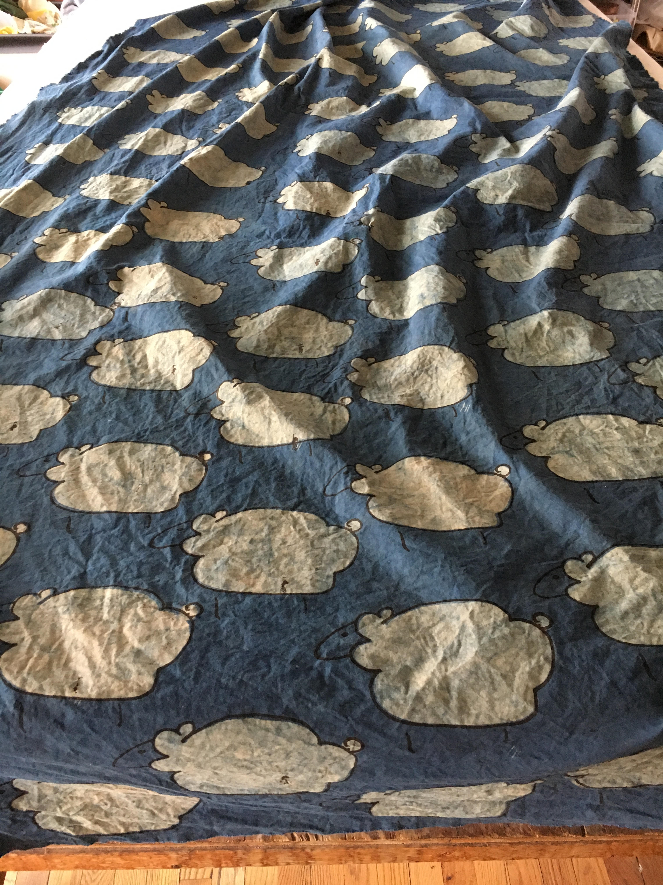
Geographic analysis
https://public.tableau.com/shared/TR4QZWMDQ?:display_count=n&:origin=viz_share_link

Slide 14
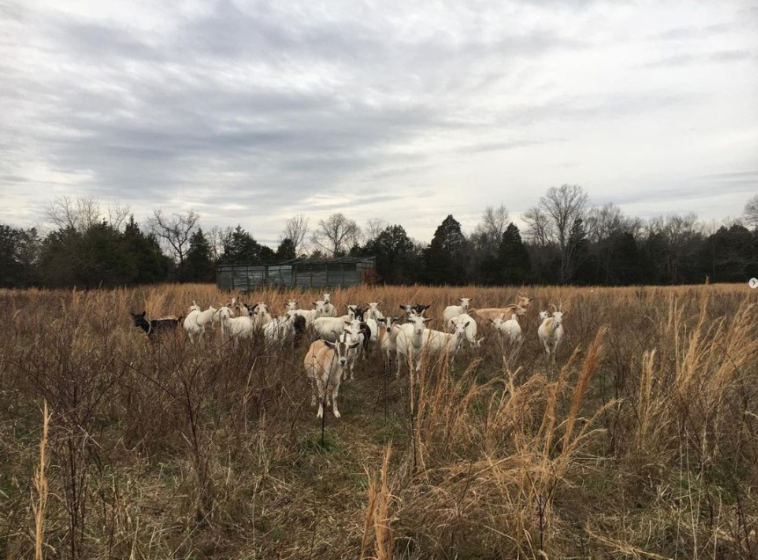
Summary & next steps
While soil health is likely impacted by the kind of animal, the amount of droppings dispersed throughout, and the forage available, there is room for further analysis and data regarding:
Seasonality of forage
Track of grazing over time
Livestock count
Calculate square footage of dung per animal per acre

Slide 15
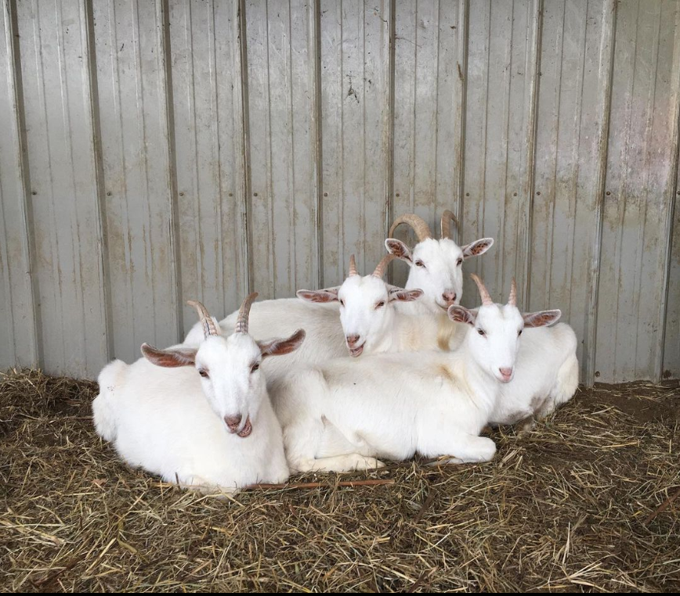
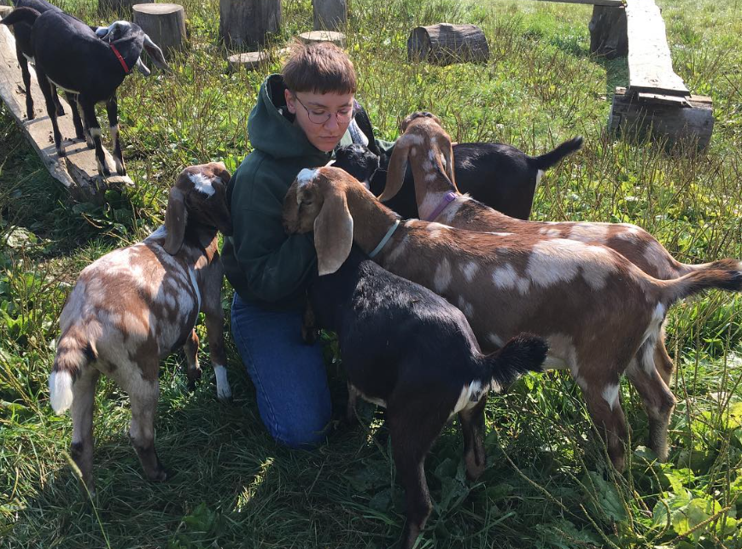
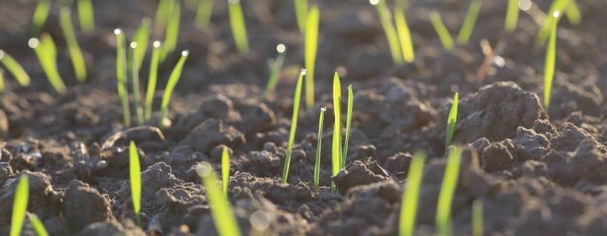
RECOMMENDATIONS
GOAT PILE
GET ABSOLUTELY BURIED BY A PILE OF BABY GOATS OR SHEEP AS SOON AS POSSIBLE
Intensive grazing
Targeted Grazing
Calculation of animal per acre
Seasonally available forage
Optimized growth time
Minimal soil disturbance
Maximum dung dispersal

Slide 16
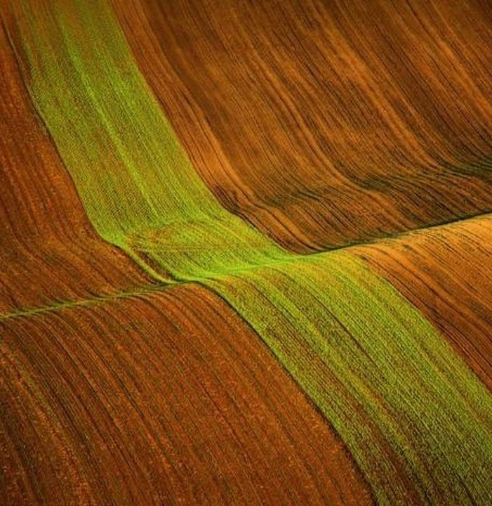
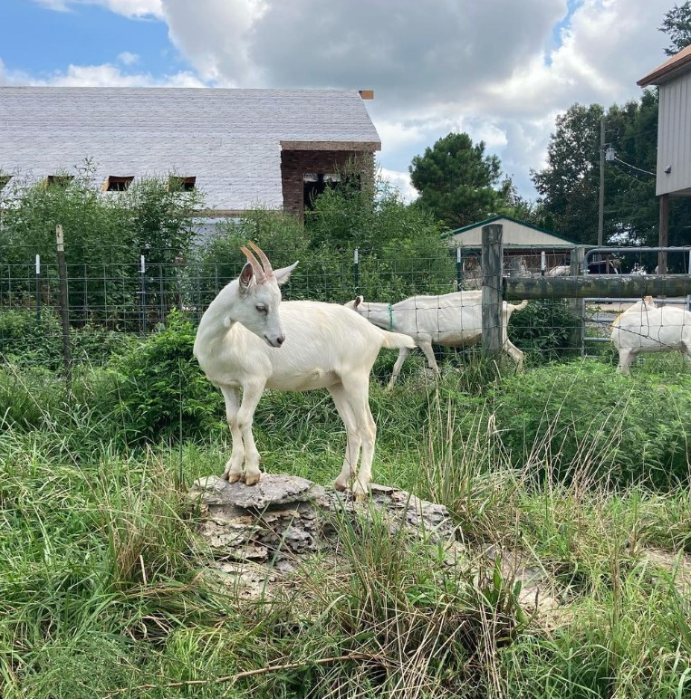
Thank you
Mel Beall​​
Nashville Software School​
Data Analysis Cohort 9

